Slide 1
Detecting Product Innovation in News Articles
Sponsor: Dr. Gizem Korkmaz, UVA Biocomplexity Institute & Initiative (BII)
Advisor: Gerard P. Learmonth
By: Keyu Chen, Ben Cosgro, Oretha Domfeh, Alex Stern
Notes:
Good afternoon,
Keyu, ben, Alex and I will be talking about how we are detecting product innovation in news articles with our sponsors Dr. Gizem Kork-mas and the Biocomplexity Institute and advisor Professor Learmonth

Slide 2
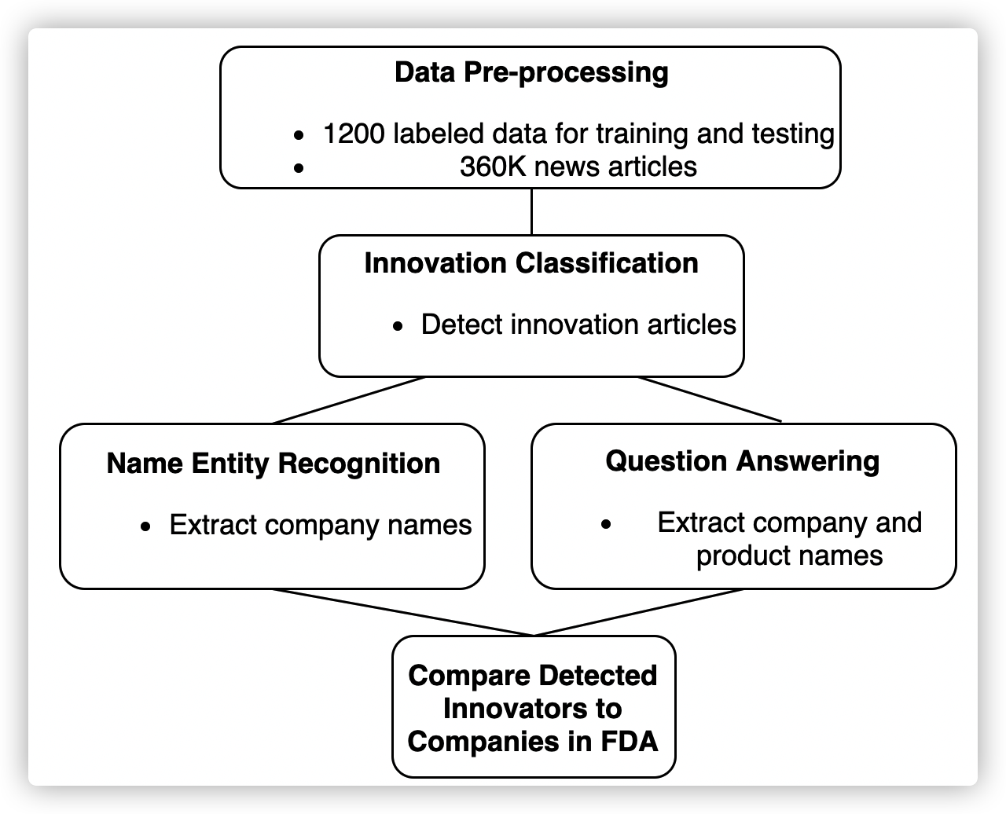
Problem Description and Methods
Sponsor: UVA Biocomplexity Institute & Initiative (BII)
Traditional Innovation Measures
Our Methods
Example BRDIS Survey Question:
During the three years 2014 to 2016, did your company introduce:​
a. New or significantly improved goods (Exclude the simple resale of new goods purchased from other companies and changes of a solely ​ aesthetic nature)? ❑ Yes ❑ No​
b. New or significantly improved services? …………… ❑ Yes ❑ No​
01
Binary Classifier
02
Named Entity Recognition
Questions we want to answer
Whether the article mentions an innovation?​
What company launched the innovation?
What are the product names that the company launched?
03
Question and Answering
Notes:
Problem Description
traditionally Innovation is measured through surveys of selected companies such as the Business R&D and Innovation Survey (BRDIS).
However this project aims to develop methods to identify and to measure business innovation using non-traditional data sources with a particular focus on opportunity data such as news articles
Thus we leverage natural language processing (NLP) and machine learning methods to measure business innovation
Currently our Focus is on detecting innovation in the pharmaceutical industry
We would like to answer questions such as
whether the article mentions an innovation?​
which company has launched a new product?​
Our Data consist of
About 1.9M news articles obtained from Dow Jones News and Article database
We trained our models on 1,200 observations of labeled articles where we hand labeled company and product names (~3% contain information about an innovation)
We will validate our findings using food and drug administration databases
Our Methods:
A huge component of our methods, is the use of BERT. BERT is a relatively new method of pre-training language representations which produces great results on NLP tasks. BERT is pre-trained on a large text corpus (like Wikipedia), and it is bi-directional, meaning it looks at the words before and after entities, to provide a richer understanding of language.
Furthermore, BERT can be deployed in variety of task specifically for our methods we
Use BERT as a binary classifier to identify articles that mention innovation
We are using it in Named Entity Recognition to extract company names from innovation articles
In addition to Question & Answering to extract company names from innovation articles as well
And then comparing them in the end with 67% overlap

Slide 3
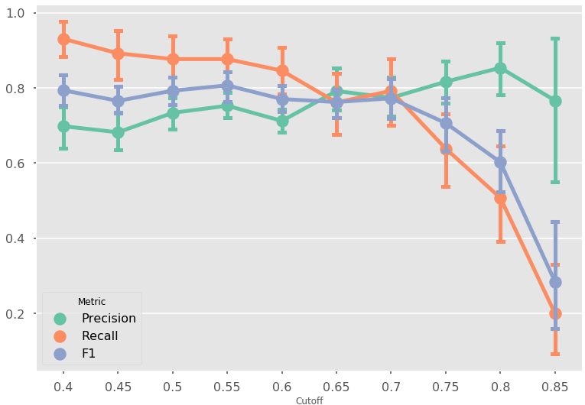
Classification
Notes:
The first task was binary classification. We tried to identify as accurately as possible which articles contained descriptions of innovations. Our problem was tricky for multiple reasons. First, the labeled training set we used had a class imbalance of almost 27:1. If we had just guessed every article didn’t contain an innovation, we’d have 97% accuracy! We solved this using downsampling. However, the size of our training set was dramatically reduced as a result. Our second problem was the precision/recall trade-off. We were slightly more concerned with grabbing as many of the innovation-containing articles than we were with accidently grabbing non-innovation containing articles. Based on testing, output in the graph above, we settled with a 0.7 cutoff value after tuning all other hyper-parameters of our model.

Slide 4
Named Entity Recognition
Identifies and categorizes entities within an article into 4 categories
Location, Person, Organization, Miscellaneous
Subset of Article Processed | Hand-Labeled Innovator | Companies from DNA
Title Only | 62.5% | 53.1%
Paragraph Only | 87.5% | 65.6%
Title and Paragraph | 90.6% | 75%
Notes:
We followed Classification by taking their innovation articles and running them through named entity recognition. While this extracts different categories of entities, we were only interested in organizations in order to identify companies. We ran NER on the title of the article, the paragraph of the article, and the title and paragraph combined. On your screen are the results when we compared the extracted organizations to our hand labeled company names and the company names identified by codes attached to the articles.

Slide 5
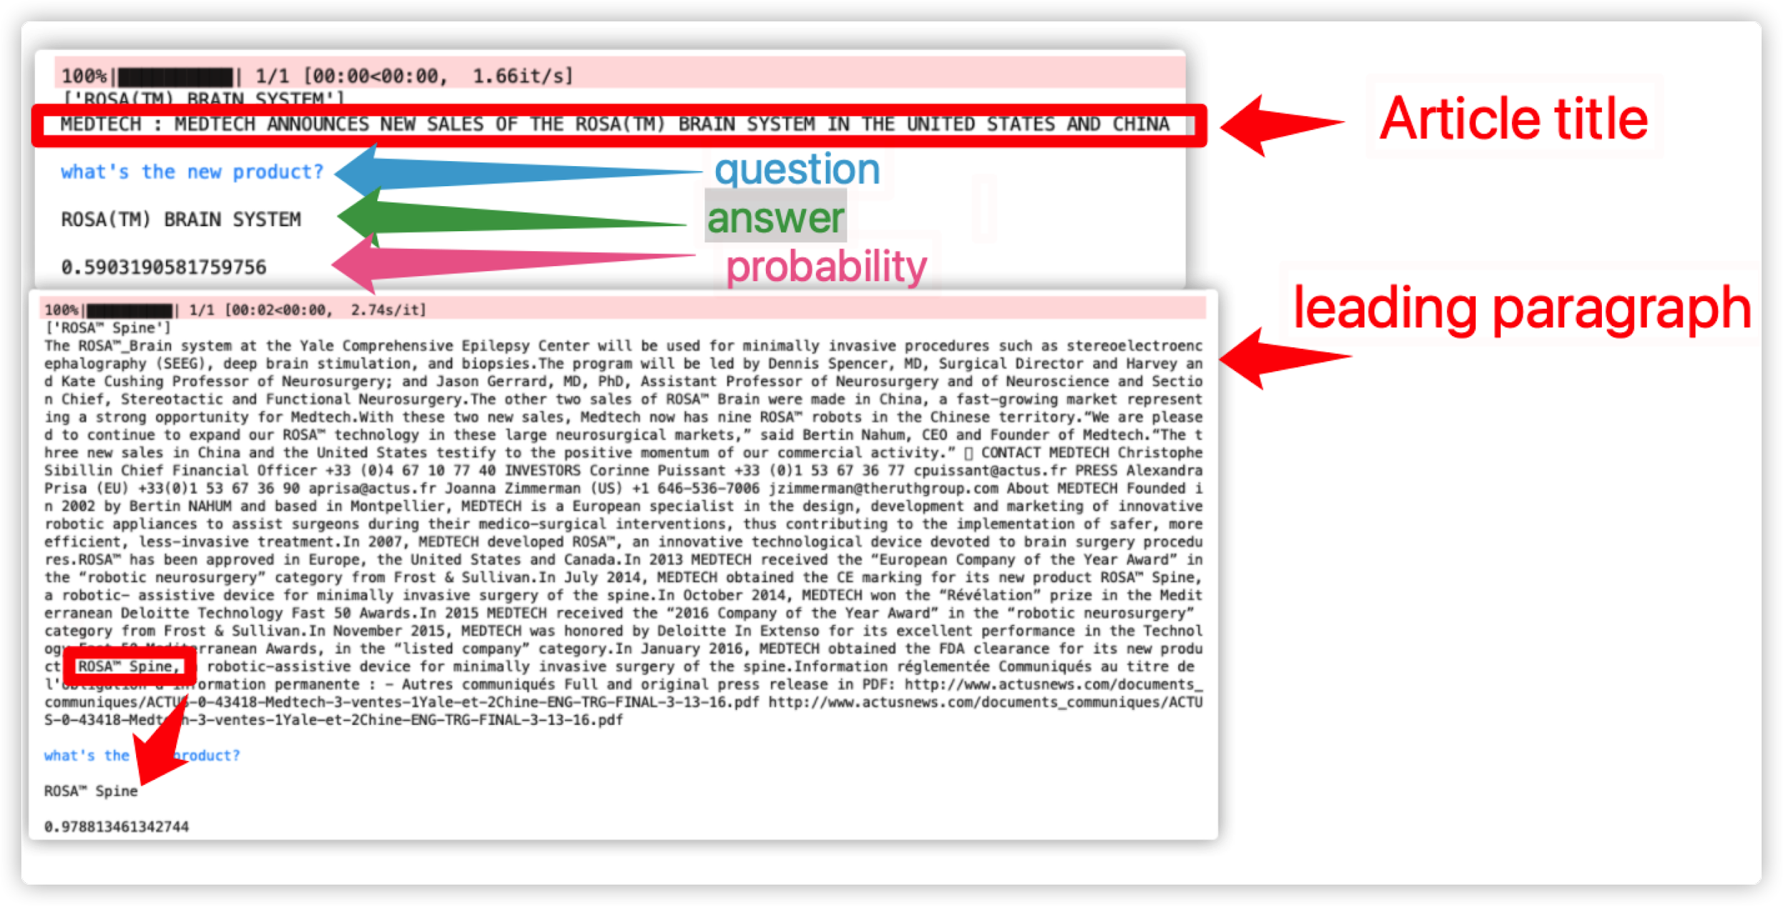
Question Answering
Retrieves key information (company and product names)
Subset of Article Processed | Company Names | Product Names
Individual answers | 78% | 81%
Combined Answers (title and title+lead) | 97% | 91%
Combined answers (title+lead) | 94% | 91%
Notes:
Our main task in Question Answering is to retrieves key information such like company and product names
This table summarizes the fuzzy matching results using the answers with the highest matching probability for each evaluation strategy.
When we matched individual answers to the company and product names, we obtained the highest accuracy values as 78% (25/32) for company and 81% (26/32) for product names.
When we compared the combined answers from title and title+lead inputs, we obtained 97% and 91% accuracy rates, for company and product names, respectively.
There was a slight decrease in the accuracy rate (3% for company names) when we used combined answers only from “title + lead” inputs, decreasing the computing time by half.
Since QA is a computationally intensive task compared to NER, we suggest bearing such a minimal decrease in accuracy to save in computational resources.
####### No need below
Retrieves key information (company and product names)
Evaluates performance on 1200 labeled articles
To evaluate the performance of the QA model, we compared the obtained answers from title and title+leading paragraph inputs to the hand-labeled company and product names. Here, we used three strategies once we obtained answers to each 12 questions (3 questions for companies, 9 questions for products):
I. we compared every single answer obtained from the title (12 individual answers) and title+lead (12 individual answers) inputs to the respective ground-truth in the labeled dataset;
II. we combined the answers from title and title+lead inputs to the company-related questions (6 answers combined), and to the product-related questions (18 answers combined), and compared these two separate answer strings to the respective company and product names in the labeled dataset; and
III. we obtained answers only from title+lead (to reduce run time), and combined the company-related answers (3 answers combined), and product-related answers (9 answers combined), and compared these two strings to the respective company and product names in the labeled dataset.

Slide 6
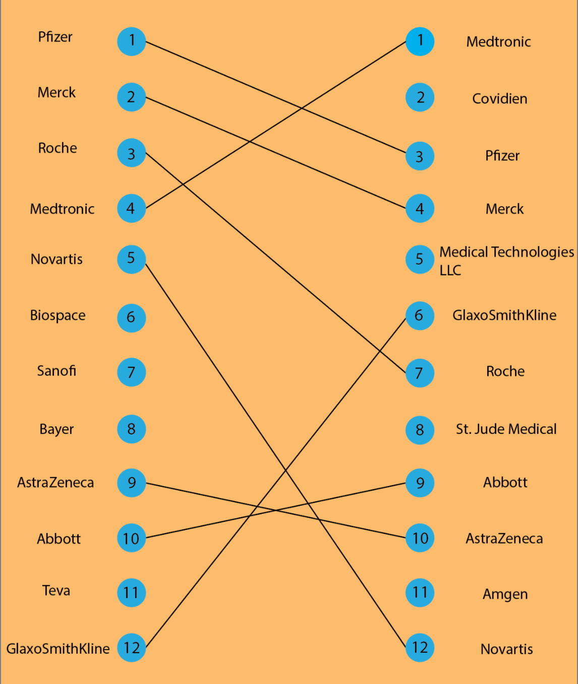
Results
Comparison of QA and NER top 12 and top 50 produces 67% matching rate
Comparison of Top 50 Unique Companies in QA and NER results to other Databases
National Drug Codes | 8%
FDA Drug Approvals | 44%
Notes:
Once we had completed all training all three processes, we ran the code on our data of all news articles from 2013. The QA was only able to complete 20,000 of our 65,000 articles, but the NER was able to run on all articles. In a comparison of the most common company names from NER and QA, we found there was an overlap of 67% in both the top 12 and top 50 lists. We then compared our QA and NER top 50 lists with the National Drug Code database from 2013 and the FDA drug approval database from 2013. While the NDC only provided an 8% match, the drug approval database matched 44% of the time. We found this promising but will need to do more research into how to improve this match. Thank you for watching!

Slide 7
Update 3/22
Accepted abstract - 5/Excellent
3 pages into paper
Question about authors
Question about length
Further metric collection
Several coding edits
Running on full datasets

Slide 8
NER Times
NER Train - 12 minutes
NER 2013 - 29 minutes
NER 2018 - 27 minutes

Slide 9
Accuracy after comparing Keyu to Ben
Comparing to company+innovator = 78.1%
Comparing to total_complete = 59.4%

Slide 10
Accuracy after dropping generic words and duplicates- NER
Title using names_company_about list = 53.1%
Title and Paragraph using names_company_about list = 75%
Paragraph using names_company_about list = 65.6%
Title only - 62.5%
Title and Paragraph - 90.6%
Paragraph only - 87.5%

Slide 11
Accuracy - NER
Validation Accuracy Training - 97.69%
Title only - 43.75% to 56.25% with concatenation
Title and Paragraph - 87.5%
Paragraph only - 81.25% or 84.38% to 87.5%
B-ORG only Title and Paragraph - 84.38% for both
B-ORG only Paragraph only - 81.25% for both
Title and Paragraph using names_company_about list = 62.5% to 75%
Title using names_company_about list = 40.63%
Paragraph using names_company_about list = 56.25% to 68.75%
B-ORG only Title and Paragraph using names_company_about list = 65.63%
B-ORG only Paragraph only using names_company_about list = 65.63%

Slide 12
Accuracy - NER
Title and Paragraph using names_company_occur_list = 31.25%
Paragraph using names_company_occur_list = 31.25%
B-ORG only Title and Paragraph using names_company_occur_list = 50%
B-ORG only Paragraph only using names_company_occur_list = 34.38%

Slide 13
Update: 3/8
Rivanna Outages
Ben: Running code against new columns and new data
Keyu: Running code against full dataset
Alex and Oretha: detailing pre-processing steps, tuning hyper-parameters, creating plots for our paper
All: Contributing to paper and further documenting metrics

Slide 14
Update: 3/1
Presented on methods as precursor to writing paper
Ben: Running code against new columns and new data
Keyu: Running code against full dataset
Alex and Oretha: pre-processing steps and explore cut-off values
All: Contributing to paper

Slide 15
Update: 2/22
Finished our abstract
Code Review
Making sure code can be reproduced and posted to the public

Slide 16
Project Timeline
Introduction to team and set up weekly meetings schedule with BII
Literature Review of BERT where it was used to classify text, as a question and answer system etc.
Analyze and explore the characteristics and features of the text data (news articles, SEC filings)
Develop a series of methods (BERT) to classify text and extra entities (company and product names) from text to develop indicators of innovation
Validate findings using existing ground-truth databases
Compile and assess findings in a report

Slide 17
Our Data
01
Dow Jones News and Analytics (DNA) Database
1.9 Million News Articles
02
1200 observations, 3% innovation
Hand-Labeled Articles
Data
03
Validate using Food and Drug Administration Databases

Slide 18
Our Methods
Binary
Classifier
Named Entity Recognition
Question and Answering
Determine which articles mention Innovation
Extract company names from innovation articles
Extract company and product names from innovation articles
BERT: Bi-directional Encoder Representations

Slide 19

Binary Classification
The Task: Flag articles that contain information about an innovation
Sigmoid Activation Function
Class Imbalance (27 : 1)
Precision / Recall Tradeoff
How it applies to our task
Notes:
So we are Filtering which articles contain info about innovation
We do this by modifying The Google BERT model and adding a node at the end: that is a sigma binary classifier as the activation function
We have a Steep class imbalance 27:1 which means that most of the articles contain info about innovation
We want Maximize both recall and precision but recall is more important: we want to gather as many positives as possible while taking into account

Slide 20
Precision (False Positives) / Recall (False Negatives)
Epochs / Learning Rate | 5e-4 (0.0005) | 1e-4 (0.0001) | 5e-5 (0.00005) | 1e-5 (0.00001) | 5e-6 (0.000005)
4 | 0.0 / 0.0 | 0.56 / 1.0 | 0.7 / 0.91 | 0.76 / 0.65 | 0.7 / 0.61
8 | 0.56 / 1.0 | 0.56 / 1.0 | 0.56 / 1.0 | 0.92 / 0.52 | 0.58 / 0.96
16 | 0.56 / 1.0 | 0.56 / 1.0 | 0.75 / 0.78 | 0.82 / 0.78 | 0.77 / 0.74
32 | 0.56 / 1.0 | 0.56 / 1.0 | 0.7 / 0.61 | 0.85/0.74 | 0.75/0.78
64 | 0.0/0.0 | 0.0/0.0 | 0.80/0.69 | 0.71/0.73 | 0.65/0.83
Notes:
This is a glimpse into our modeling process.

Slide 21
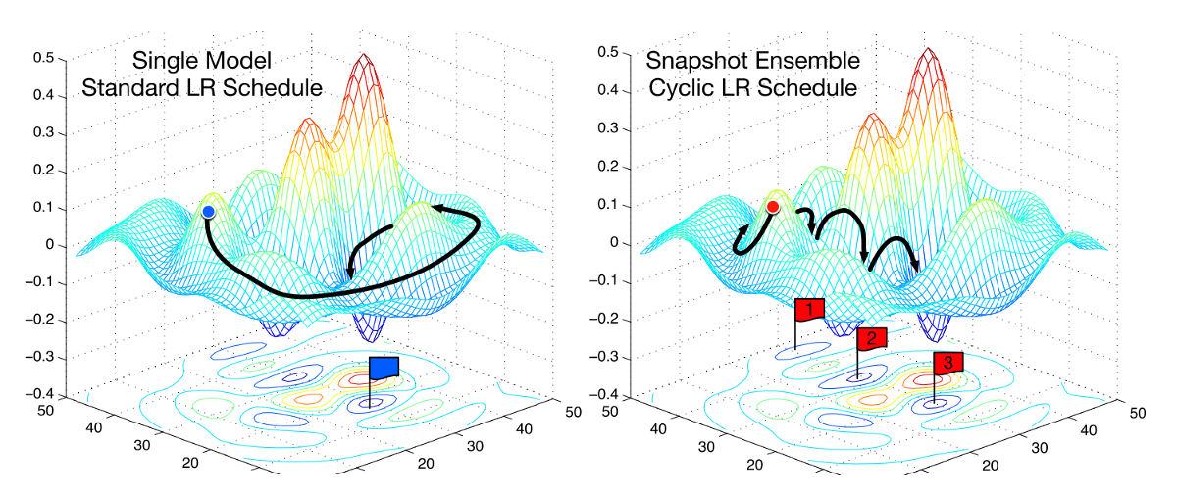
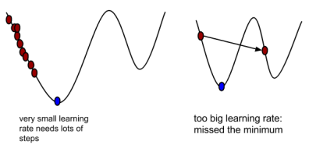
The Classification Model
Google BERT NLP Algorithm
Pre-trained
Transfer Learning
81% Precision / 89% Recall
Notes:
Use transfer learning to adapt to taks with hand labels set of articles
Only changing the last few layer : we are training the last couple of layers
Cutoff is 0.35

Slide 22
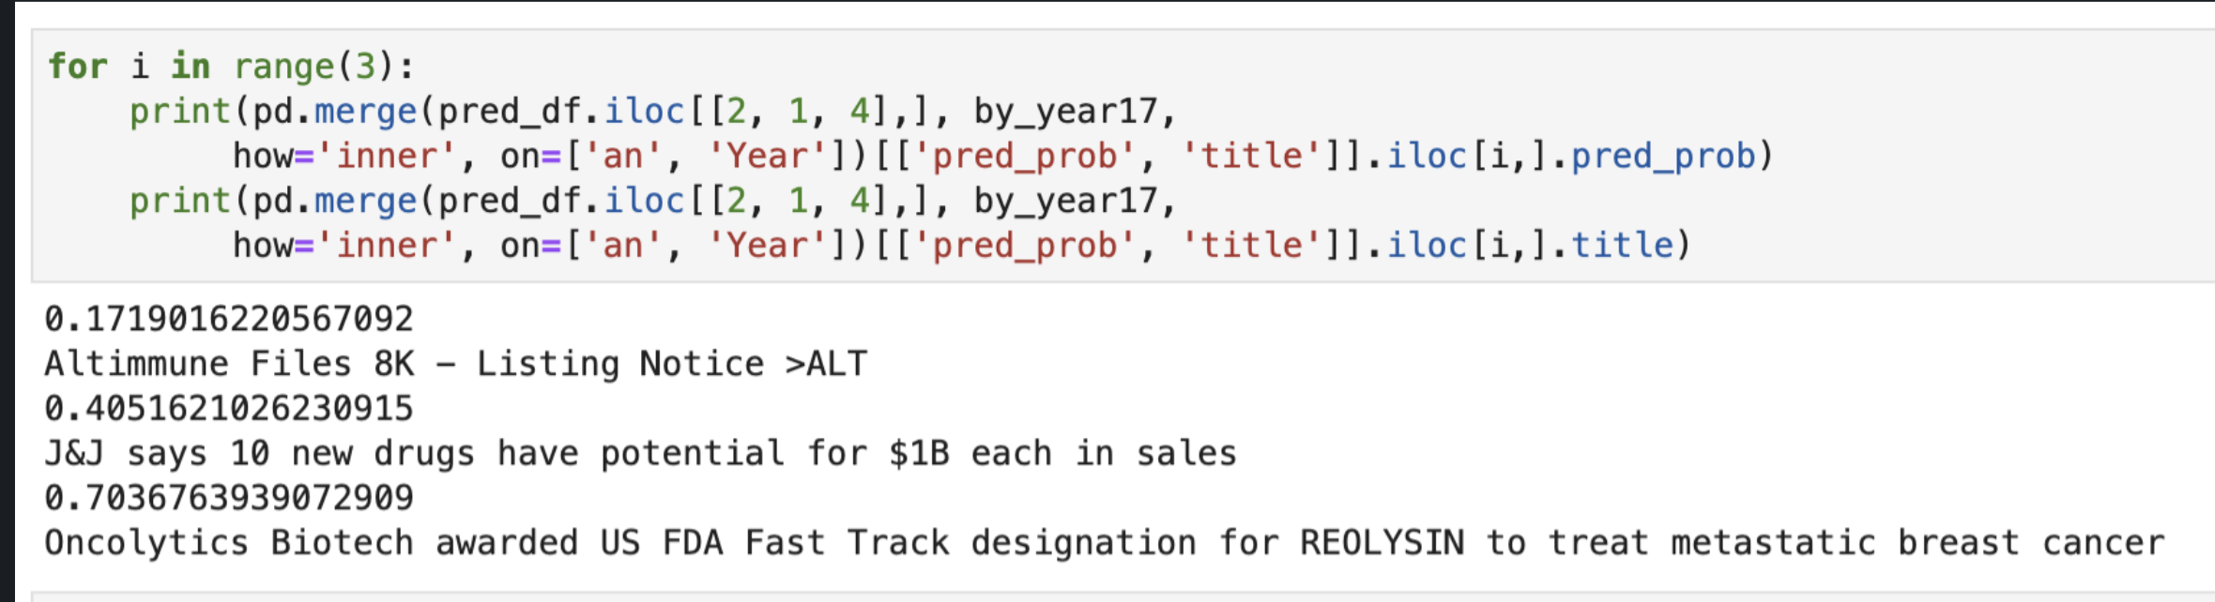
Example Articles
Altimmune Files 8k - Listing Notice > ALT
Innovation Yes/No Probability:
0.17
J&J says 10 new drugs have the potential for $1B each in sales
Innovation Yes/No Probability:
0.41
Oncolytics Biotech awarded US FDA Fast Track designation...
Innovation Yes/No Probability:
.70
Interpretation Risk
Innovation Yes/No Probability:
Notes:
Add more articles to this!
2017 test data set (unseen)
Titles for the articles, classification based on the title or paragraph?

Slide 23
Preprocessing Steps
Attach title to lead paragraph and clipping to 512 characters
Data Wrangling
Made training set labels 50% positive and 50% negative
Train/test Manipulation
Added special tokens at the beginning and end of each text
Tokenization
Preprocessing Steps
Padding
If the sentence the model receives is too small we add empty tokens
Token IDs
Convert tokens into things BERT recognizes
Attention mapping
Randomly blurs out words to learn context
Notes:
Overview:
Our training data set consist of 1200 observations. We have a binary response variable called y: where 1 = Yes (innovation), 0 = No (No innovation). As it stands the training dataset is very imbalanced out of the 1200 observations, we have 32 articles that are labeled Yes (which is 2.6% of the data and 1168 articles labeled No
Preprocessing steps
Data wrangling:
Attach title to lead paragraph:
Here we are creating a new column in a dataframe called 'text' which consists of combining the lead_paragraph and the title together into one. Then we have to clip it to 512 characters because that is BERT's limit
Clipping to 512 characters (max number of characters for BERT)
Training/test manipulation,
training set 50/50 positive and negatives which lowered the size of our training set
Making sure we have are generating a randomized set of 32 ‘no’ innovation observations and combining it with our true ‘yes’ innovation observations
Split training set into a test and train set. The Split is 60-40
Tokenization: Add special tokens at the beginning (CLS) and end of each sentence (SEP)
CLS: aggregate sequence representation for classification tasks.
SEP: added at the end to separate sentences
Tokenizing the text (title with body) from the training data set (1200 articles)
Pad the input tokens
The BERT model receives a fixed length of sentence as input. Usually the maximum length of a sentence depends on the data we are working on. For sentences that are shorter than this maximum length, we will have to add paddings (empty tokens) to the sentences to make up the length. In the original implementation, the token [PAD] is used to represent paddings to the sentence.
Convert tokens into IDs
Based on the pretrain corpus, If BERT does not understand the word, it breaks it into prefixes and suffixes
Create attention map: randomly blurs out stuff, similar to dropout, makes things more robust
Sources: https://albertauyeung.github.io/2020/06/19/bert-tokenization.html

Slide 24
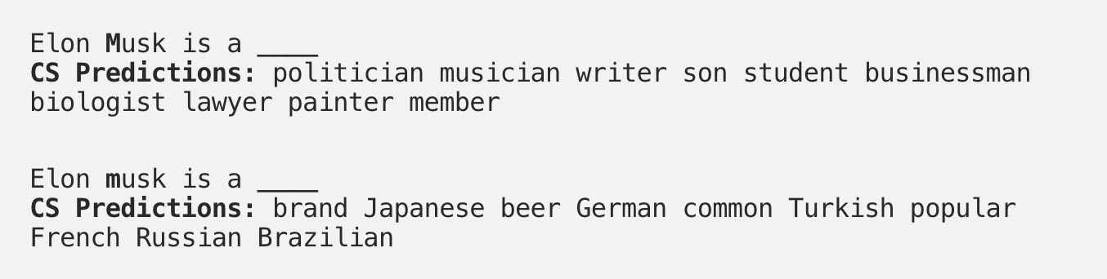
Name Entity Recognition with BERT
Identifies and categorizes entities into 4 categories
Location, Person, Organization, Miscellaneous
Tokenizes words
Craftsbury becomes Crafts## and ##bury
Sentence context
John works at _______.
Can also use case for clues
Some items are already labeled in BERT’s 30k word vocabulary
Can fine tune by training on a corpus

Slide 25
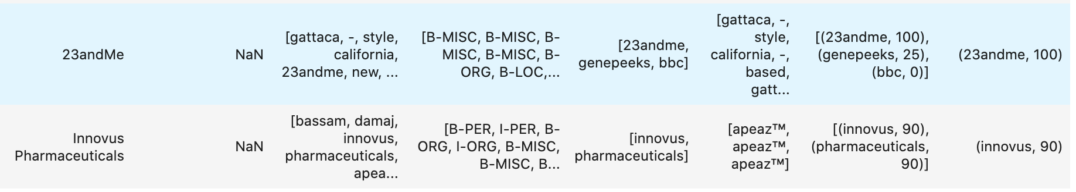
Named Entity Recognition for BII
Identifies and categorizes objects within a sentence or paragraph
Purpose - Find names of products and companies identified in articles
Training Data - ColNLL-2003
Location, Person, Organization, Miscellaneous
Fuzzy Match with Pre-identified Innovators
Current success rate of 97%

Slide 26
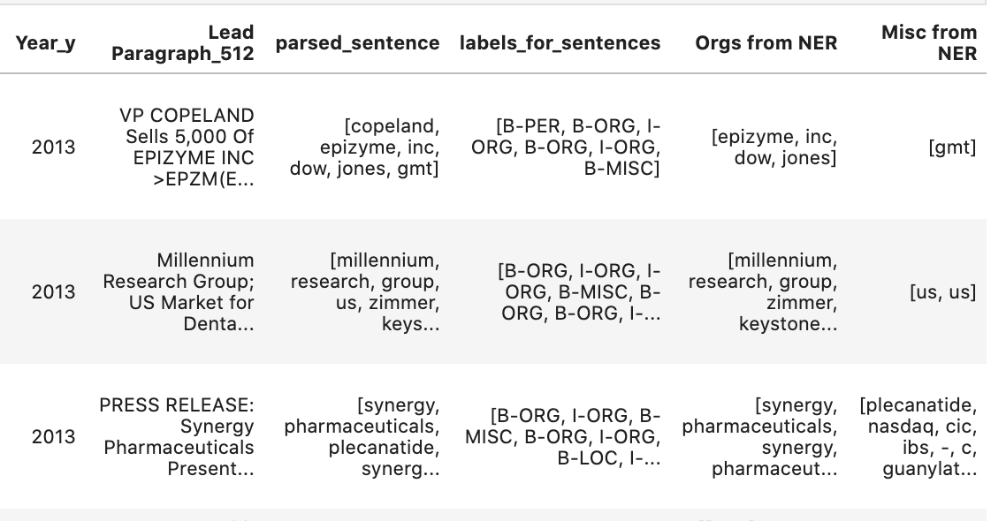
Results from 2013 Dataset

Slide 27
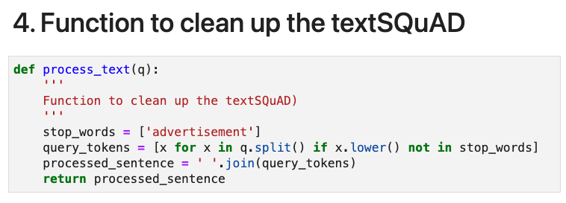
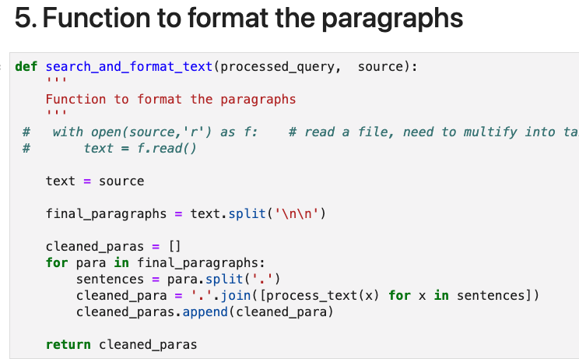

Slide 28
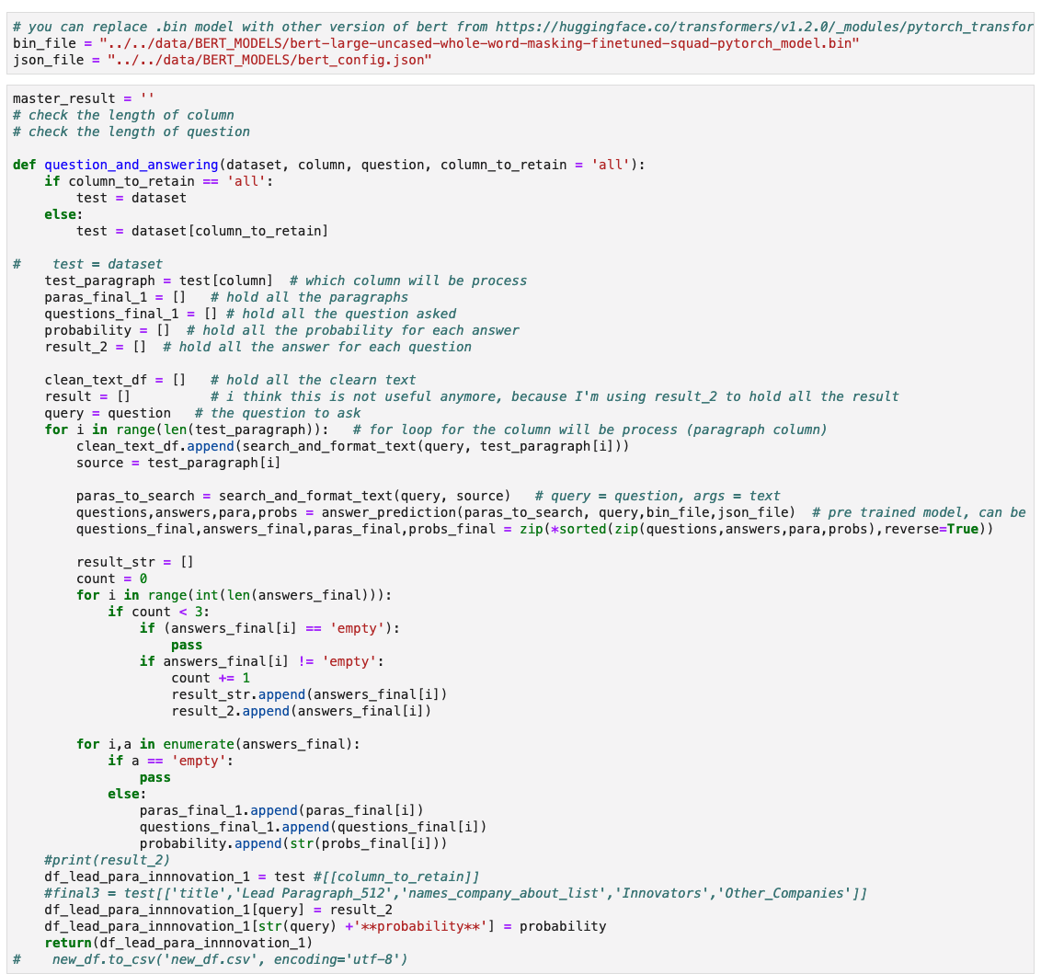

Slide 29
Question Answering
Notes:
The main task of Question Answering System is to extract the key information we need such like the name of the company, product, or devices.
This breakthrough was the result of Google research on transformers:
models that process words in relation to all the other words in a sentence, rather than one-by-one in order.
BERT models can therefore consider the full context of a word
by looking at the words that come before and after it—particularly useful for understanding the intent behind search queries.
In this examples, we have the Article title and leading paragraph passed to the model and asked the question “what’s the new product?”
Then the answer and its probability that was returned.
After pre-training, BERT works like a neural network — it passes words through a series of transformer layers (equivalent to a hidden layer in a neural network) and returns the output.
Language modelling, at its core, is gathering the probability of a word occurring in a certain context — for instance, “it’s raining cats and ___”, a language model would output ‘cat’ with the highest probability.
BERT also uses a next sentence prediction task to pretrain the model for tasks in which the understanding of the relationship between two sentences is necessary, such as for question answering

Slide 30
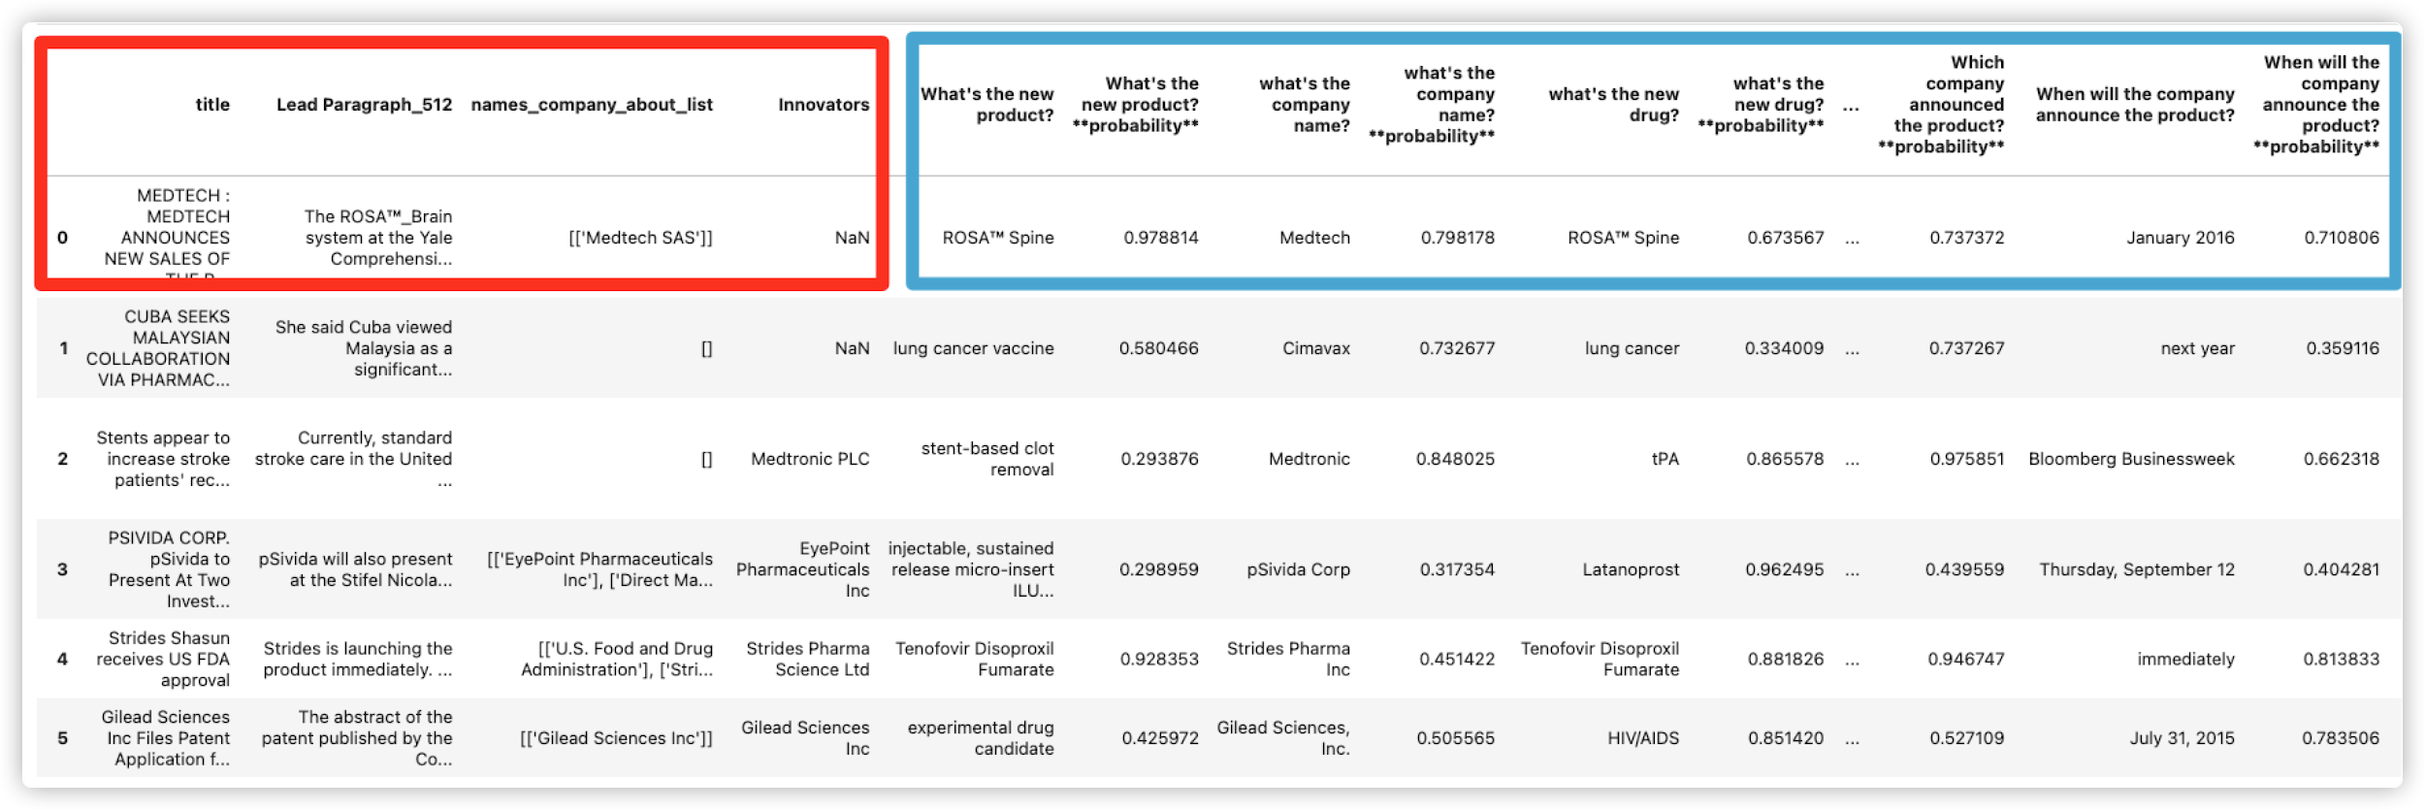
Question Answering
Notes:
After processing multiple articles, we organize all the result into a dataframe, each row will represent one article, the red rectangle shows the title leading paragraph, and labeled data, and at the right hand side, the blue rectangle, is all the answered and probability

Slide 31
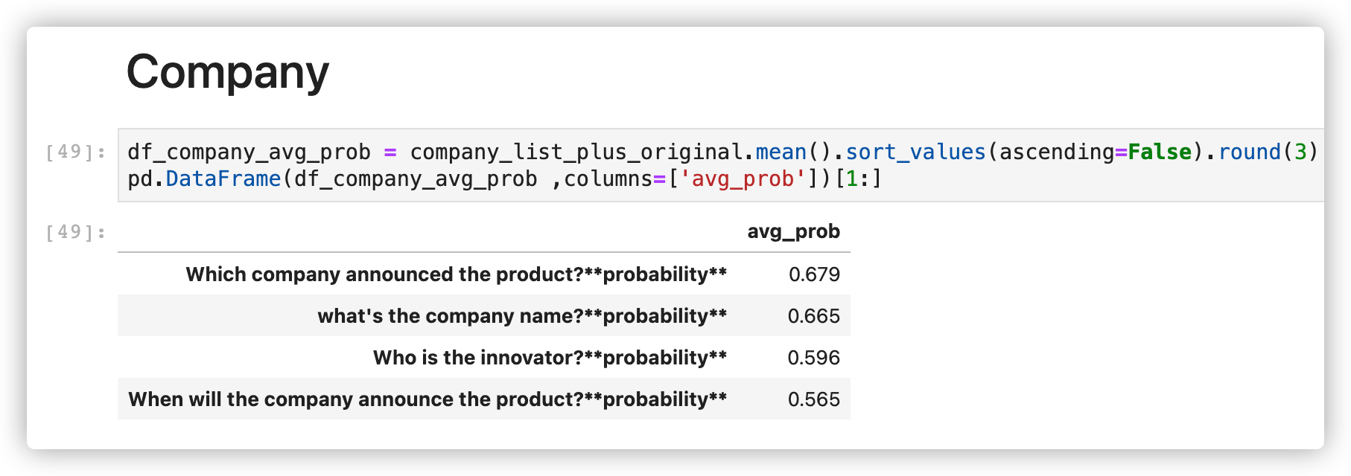
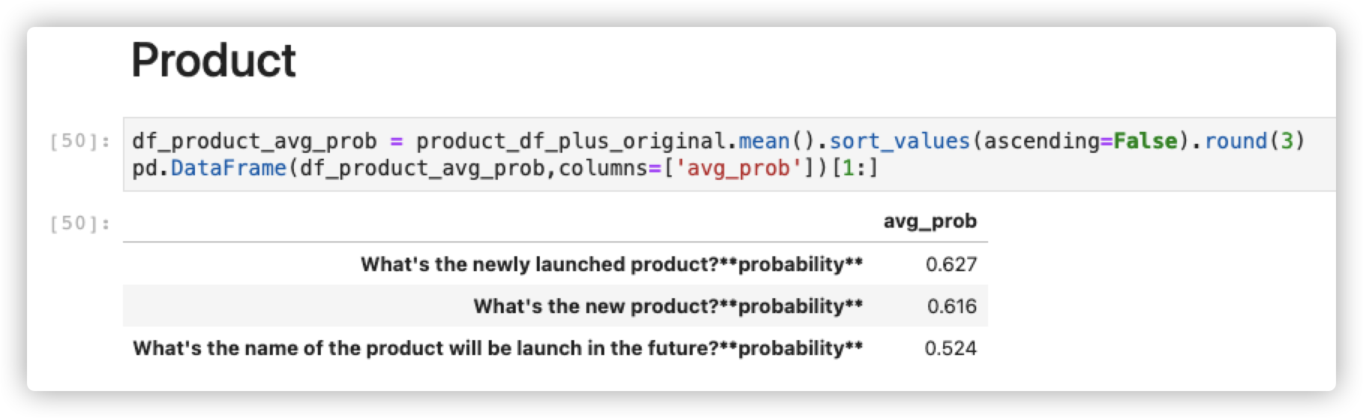
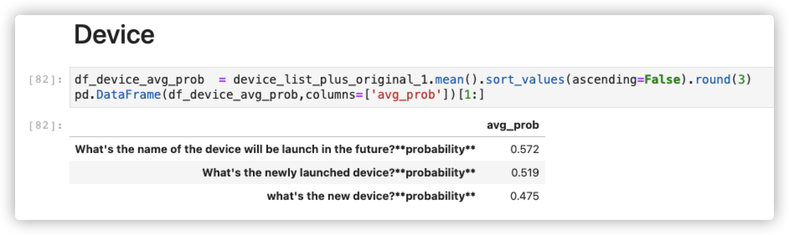
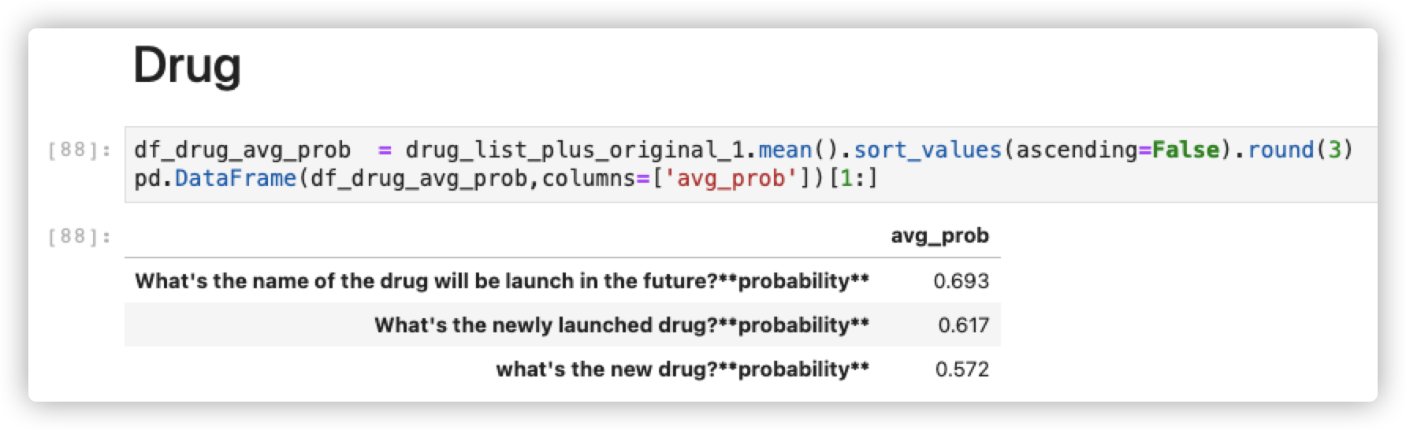
Determining the Optimal Question
Notes:
In order to determine the optimal question to ask, we calculate the average probability to see the general performance of the question we asked.
We seperate the question into 4 category, Company, Product, Device and Drug.

Slide 32
Conclusion and Next Steps
We have developed classification, NER, and Question & Answering algorithms using the 1,200 labeled article dataset
Our next step is to evaluate our methods
Apply these algorithms to 1.9M unseen news articles
Compare to FDA database for validation

Slide 33
Questions?

Slide 34
What’s Bert?
BERT, or Bidirectional Encoder Representations from Transformers, is a new method of pre-training language representations which obtains state-of-the-art results on a wide array of Natural Language Processing (NLP) tasks.
BERT is a method of pre-training language representations, meaning that we train a general-purpose "language understanding" model on a large text corpus (like Wikipedia), and then use that model for downstream NLP tasks that we care about (like question answering). BERT outperforms previous methods because it is the first unsupervised, deeply bidirectional system for pre-training NLP.
Notes:
BERT, or Bidirectional Encoder Representations from Transformers, is a new method of pre-training language representations which obtains state-of-the-art results on a wide array of Natural Language Processing (NLP) tasks.
BERT is a method of pre-training language representations, meaning that we train a general-purpose "language understanding" model on a large text corpus (like Wikipedia), and then use that model for downstream NLP tasks that we care about (like question answering). BERT outperforms previous methods because it is the first unsupervised, deeply bidirectional system for pre-training NLP.

Slide 35
What can Bert do?
Question answering
Sentiment analysis
Softmax / Categorical Prediction
Natural Language Inference
Linguistic Acceptability Analysis
Textual Entailment
Semantic Similarity Analysis
Paraphrase Detection
Named entity recognition
speech tagging
Bi-Directional Language Processing
Notes:
https://medium.com/analytics-vidhya/bert-for-everyone-f876f3bd3383

Slide 36
Week 12: Updates from BII (Name Entity Recognition)
Code works now
Sorting
Location, Person, Organization, Misc
Comparison
Keyu Q&A

Slide 37
Gradient Descent
Notes:
Finding the parameters achieve the local maximum of efficiency which is the red spot in this picture
The main parameters we are working on is the learning rate and the amount of epochs
Small learning rate the model corrects itself slightly, if it is too large you cna overcorrect
With epochs: One Epoch is when an ENTIRE dataset is passed forward and backward through the neural network only ONCE.small epochs leads to underfitting,
Large learning rate

Slide 38
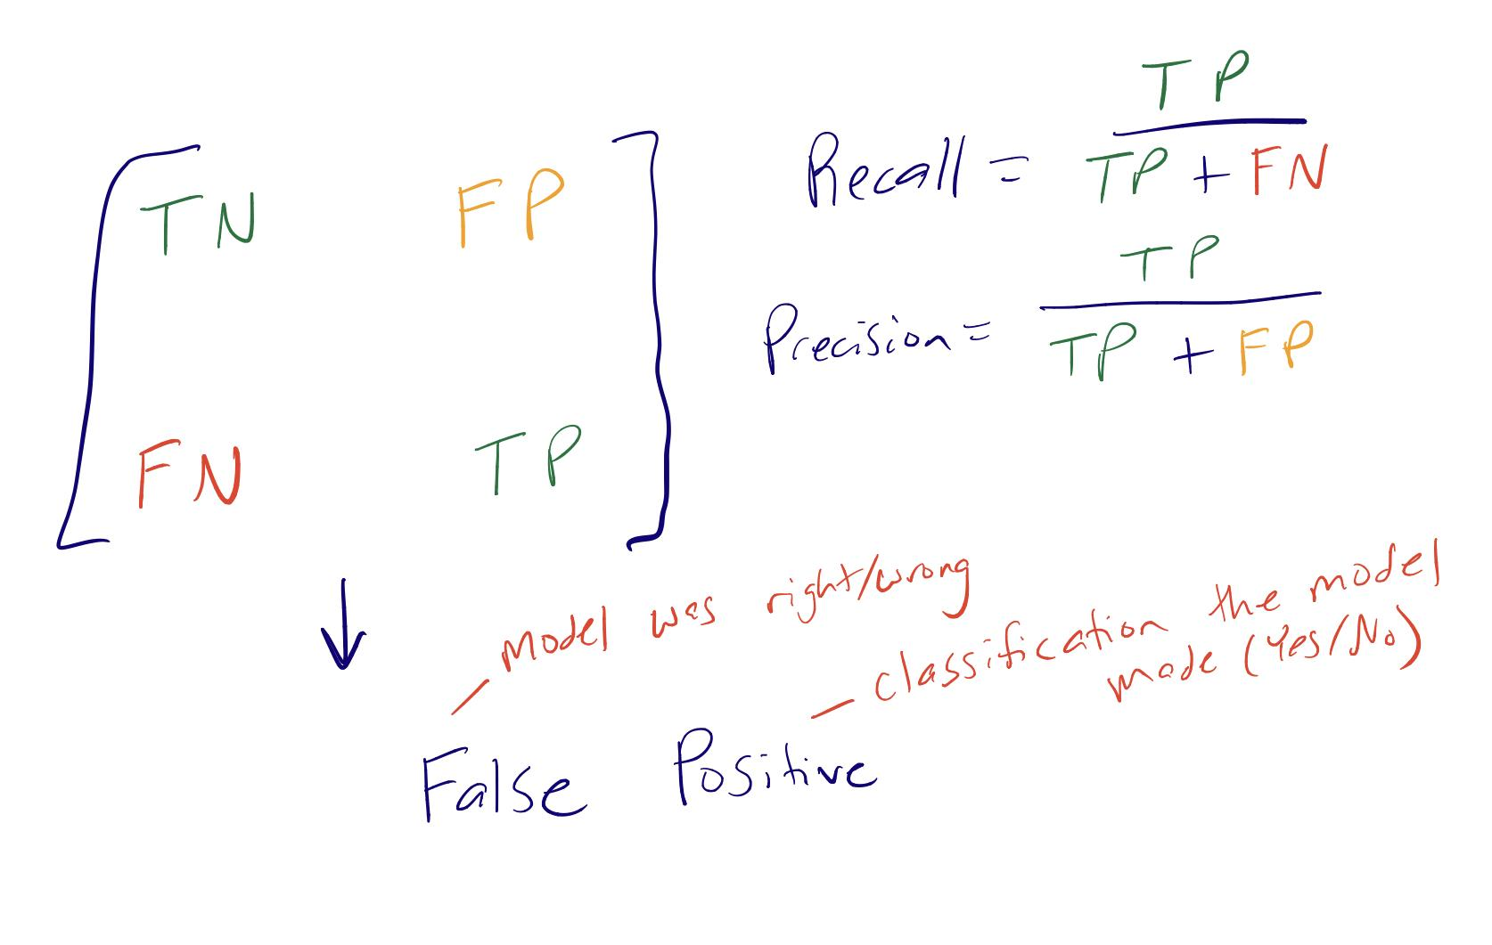
Confusion Matrix

Slide 39
Learning Rate: 1e-05 (robust across randomly sampled training sets)
EPOCHS: 128, CUTOFF VALUE: 0.35
[[11 6],
[1 18]] (75% Precision, 95% Recall)
EPOCHS: 32, CUTOFF VALUE: 0.4
[[13 4],
[2 17]] (81% Precision, 89% Recall)
Notes:
We got a new data set that wa smaller and had 37 obs labeled innovation instead of 200
And ran our classification model again , which produced a variety of models and corresponding confusion matrices
These confusion matrices represent the best 2 models
And as you can see we are making a trade off We are trying to capture at least 90% of articles that talk about innovatin in industry even if it means 20;25% of the articles we be mislabeled as innovaition when it is not
Cut off: 0.35 (threshold for our classification)
6 False positives, so the modeled labeled it innovation when it was not
But the model incorrectly labeled one observation wrong by saying there is no innovation but there was
So here we are labeling more models innovation in order to minimize false negatives
Only 4 labeled yes innovation when there was not : slightly higher cutoff values

Slide 40
Week 12: Updates from BII (Classification)
Classification:
Researched about BERT for Sequenced Classification
Generated a preliminary Confusion Matrix
Whats Next:
Our model outputs probability instead of hard classifications, therefore we want to test out different thresholds for classification
Random sampling of the training dataset

Slide 41
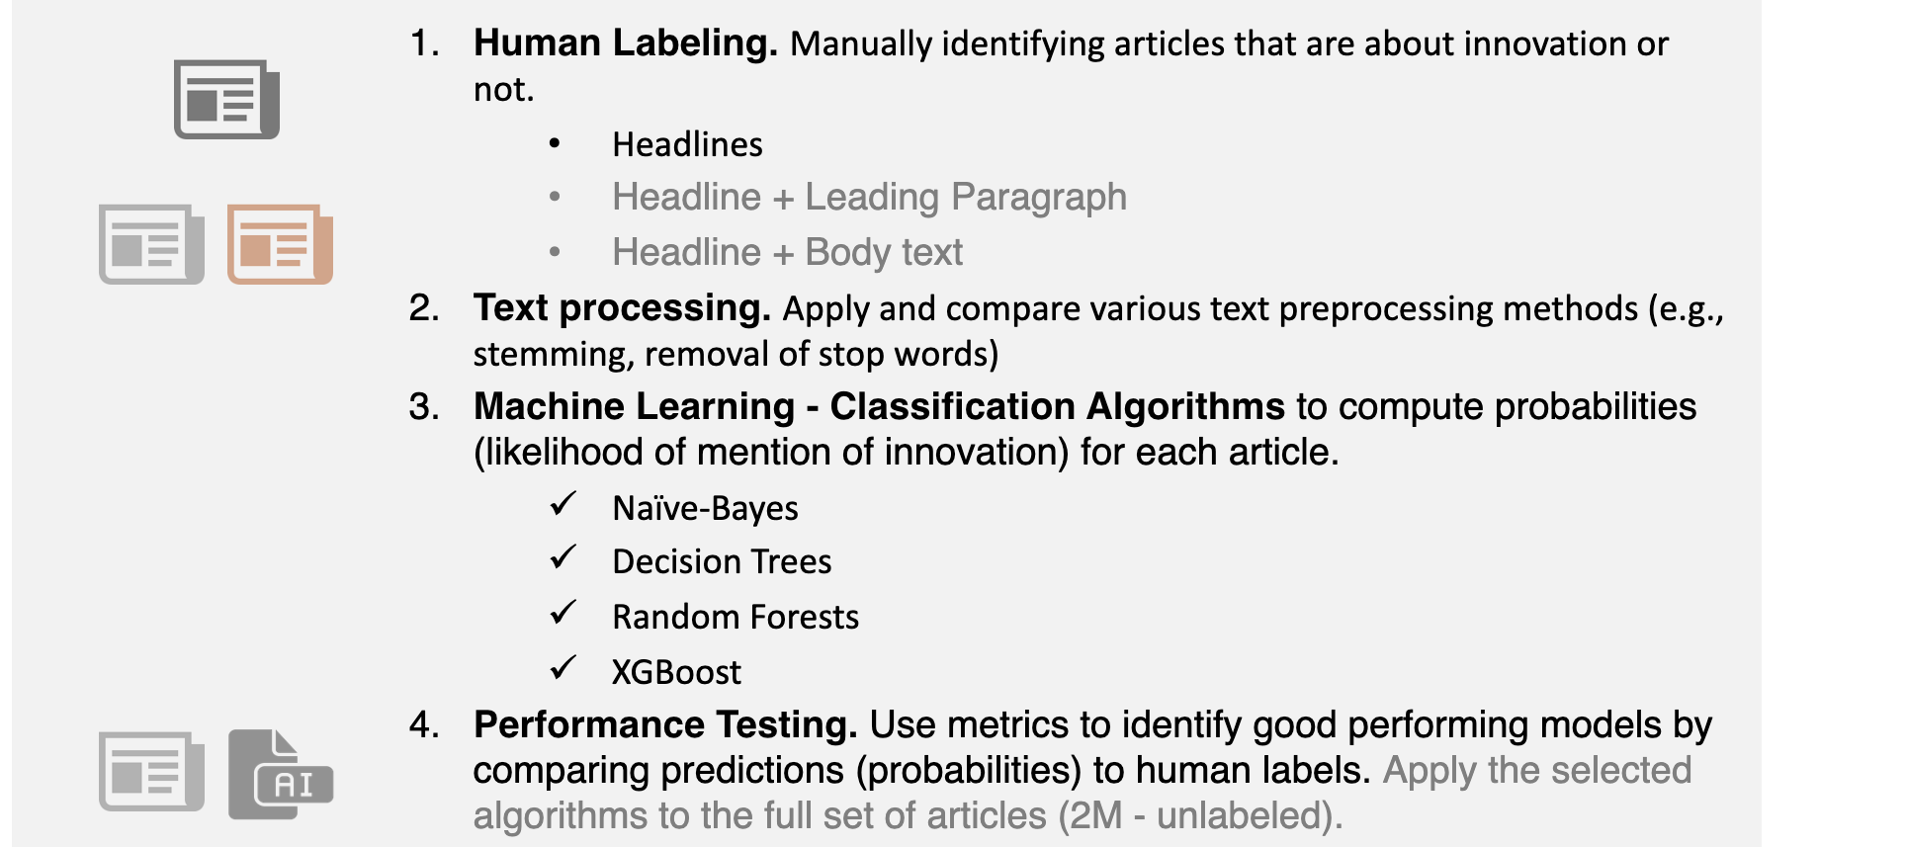
Text Classification Models with BERT
Notes:
So we are working with a labeled data set consisting of leading paragraphs labeled yes or no innovation
So far we worked on building a classification model that had a accuracy of 90% using leading paragraph
Next we are going t train the model on the leading paragraph
Create a confusion matrix to calculate precision, and recall.
With a baseline of predicted no based on title and performance on title labels
and see how BERT is performing against the Baseline

Slide 42
Weekly Tasks
Project Proposal
Written but needs formatted
Data Access
Access to the full data is still incoming but have access to the training set
Code Implementation
Able to pull in our code but still figuring out how to implement and packages within
Labeling
Still adding on to our training data

Slide 43
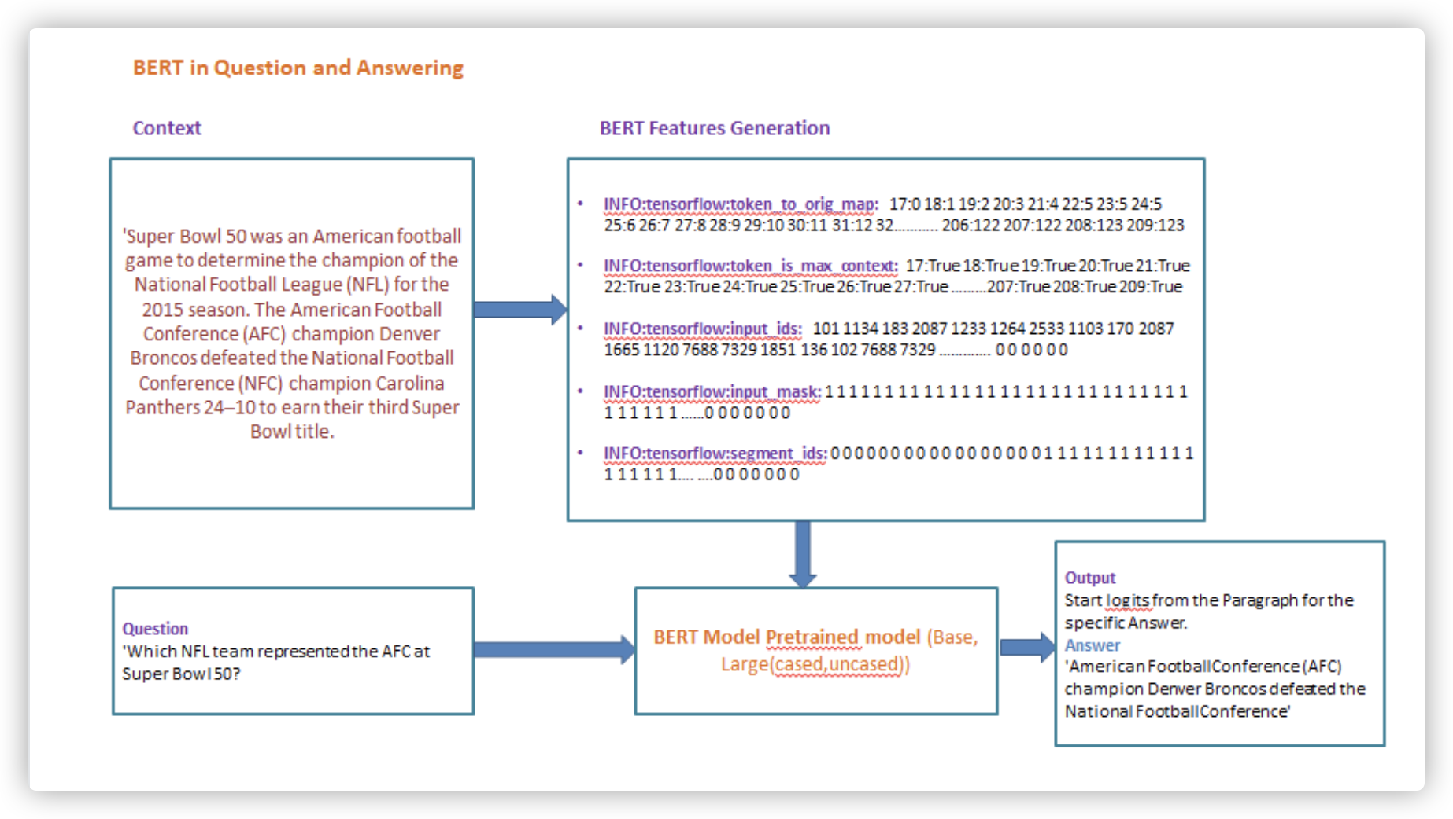

Slide 44
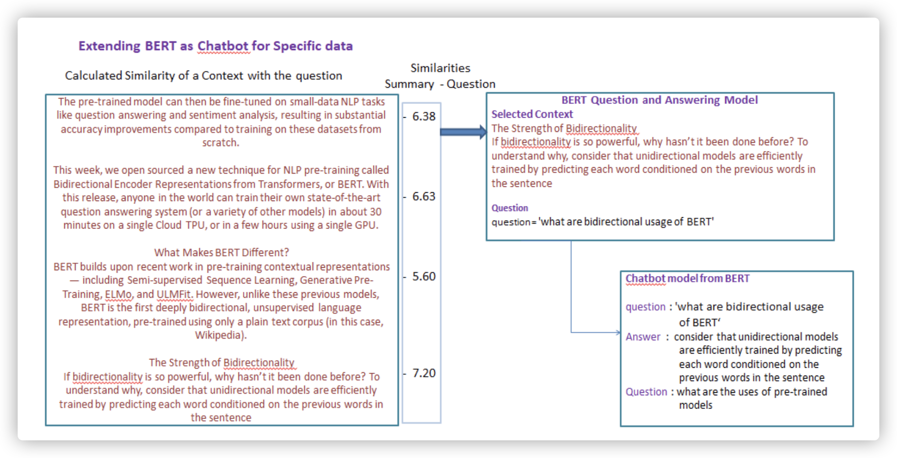

Slide 45
Appendix

Slide 46
Data
Sources:
SEC filing
Newspaper Articles
Dow Jones Articles
Scale:
Smaller subsets for comparing models
Millions of articles in full, private dataset
Further Development:
Apply to other industries (finance, patents, etc.)

Slide 47
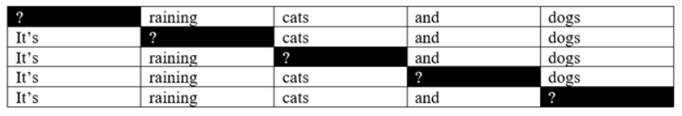
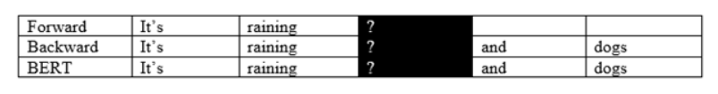
Why BERT is different from the standard language models
There is no need to train language models from left to right when there is no need to generate sentences — so instead of predicting the next word after a sequence of words like standard language models, BERT randomly covers words in a sentence and predicts them.
Notes:
Traditional Language models: are usually trained in the manner we read — from left to right. They are given a sequence of words and must predict the next word.

Slide 48
Limitations of Bert
Bert is not suitable for all NLP applications
- Bert is good at
- Classification
- Named entity recognition
- and part of speech tagging
- question/answering
- giving a passage of text
- predicting whether that passage of text addresses the question that's being asked
- trying to answer questions by pointing you to pieces of text
- Not good at
- language modeling
- What the next word in the sentence is likely to be
- text generation or translation
Notes:
What BERT is not: Lessons from a new suite of psycholinguistic diagnostics for language models
https://arxiv.org/abs/1907.13528v1

Slide 49
Our Team
Roles
Alex Stern: Point of Contact, Data, Code, Writing
Oretha Domfeh: Record Keeping, Data, Code, Writing
Ben Cosgro: Record Keeping, Data, Code, Writing
Keyu Chen: Record Keeping, Data, Code, Writing

Slide 50
Project Description: Detecting Product Innovation in News Articles (Sponsor: UVA Biocomplexity Institute & Initiative (BII))
Description: This project aims to develop methods to identify and to measure business innovation by focusing on opportunity data (e.g., news articles). We aim to leverage natural language processing (NLP) and machine learning methods to measure business innovation using non-traditional data sources to enrich and complement current innovation measures.
Notes:
So we are working with UVA biocomplexity institute and initiative to detect product innovation
Currently companies in US use BRDIS
Stands for: Business R & D and Innovation Survey
We aim to leverage natural language processing (NLP) and machine learning methods to measure business innovation using non-traditional data sources (social media, news articles) to enrich and complement current innovation measures.
The main question is can we use text based data sources to get information we get in BRDIS surveys
We are focusing on product innovation because we believe companies are most likely to announce product news
Currently, we are completing a pilot on the pharmaceutical and medical device industry and based on 1M news articles and over 5,000 company filings.
Point of contact:

Slide 51
Lecture review

Slide 52
Lecture review
Keyu Chen

Slide 53
Question Answering (QA)
the task of retrieving answers to a given question.
It is an intelligent search engine based on natural language processing and information retrieval techniques.
It has been explored both in the open-domain setting [1] and domain-specific settings

Slide 54
Reviewed articles
Adapting BERT question answering for the medical domain
Extending Google-BERT as Question and Answering model and Chatbot
Deep scaled dot-product attention based domain adaptation model for biomedical question answering

Slide 55
Some examples of natural language document collections used for question answering systems include:
a local collection of reference texts
internal organization documents and web pages
compiled newswire reports
a set of Wikipedia pages
a subset of World Wide Web pages
Question answering research attempts to deal with a wide range of question types including: fact, list, definition, How, Why, hypothetical, semantically constrained, and cross-lingual questions.

Slide 56
Article: Adapting BERT question answering for the medical domain
Key takeaway:
Models trained on the general domain dataset do not perform well on the domain-specific datasets.
To adapt to the domain, task-driven fine-tuning with domain-specific QA dataset is one of the most important steps.
Domain adaptation by LM training with limited data (with only available paragraphs or clinical notes from QA dataset) gives a marginal improvement in performance.
Adding domain-specific words by replacing the placeholder from the original vocabulary helps the model to learn those words better.
Notes:
https://medium.com/analytics-vidhya/adapting-bert-question-answering-for-the-medical-domain-2085ada8ceb1

Slide 57
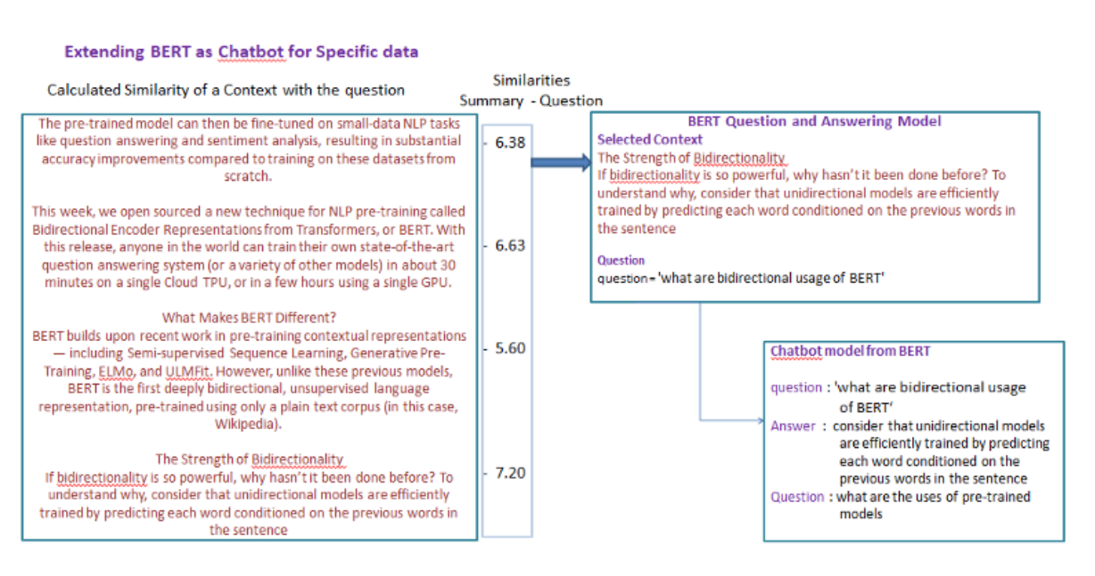
Article: Extending Google-BERT as Question and Answering model and Chatbot
Notes:
Github: https://github.com/matrixnl/Extending-Google-BERT-as-Question-and-Answering-model-and-Chatbot
Bert model is well defined in understanding the given Text summary and answering the question from that summary.
To understand the Question-related information Bert has trained on SQUAD data set and other labeled Question and answer dataset.
BERT Question and Answer system meant and works well for only limited number of words summary like 1 to 2 paragraphs only. It can’t be able to answer well from understanding more than 10 pages of data. We can extend the BERT question and answer model to work as chatbot on large text. To accomplish the understanding of more than 10 pages of data, here we have used a specific approach of picking the data.
Will it work with our project?
Probably not.
BERT Question and Answer system meant and works well for the only limited number of words summary like 1 to 2 paragraphs only. It can’t be able to answer well from understanding more than 10 pages of data. We can’t expect to have good results with a large corpus as it is trained on SQuAD question and answer data, which has less summary paragraph and questions related to that.
Stanford Question Answering Dataset (SQuAD) is a reading comprehension dataset, consisting of questions posed by crowdworkers on a set of Wikipedia articles, where the answer to every question is a segment of text, or span, from the corresponding reading passage, or the question might be unanswerable.
SQuAD2.0 combines the 100,000 questions in SQuAD1.1 with over 50,000 new, unanswerable questions written adversarially by crowdworkers to look similar to answerable ones.

Slide 58
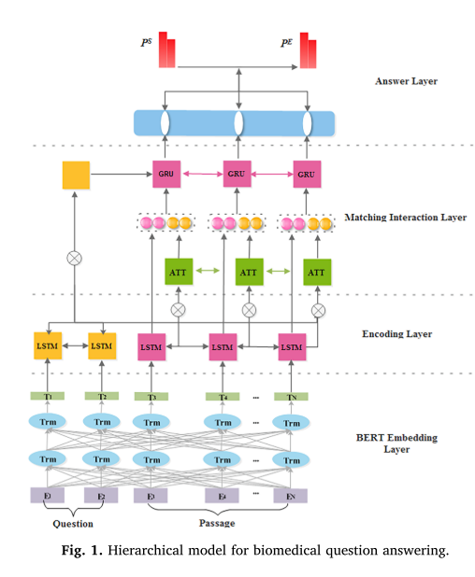
Deep scaled dot-product attention based domain adaptation model for biomedical question answering
Deep scaled dot-product attention based domain adaptation model for biomedical question answering
4 layers:
BERT embedding
Encoding
Matching interaction
Answer layer
The hidden representation of each token for question and passage is generated by BioBERT which effectively leverages domain specific knowledge from a large set of unannotated biomedical texts.
Notes:
https://doi.org/10.1016/j.ymeth.2019.06.024
The model is pre-trained on the large-scale open domain dataset SQuAD and fine-tuning is implemented on the small target data BioASQ. The experimental results show that our model gets the state-of- the-art performance on Biomedical Question Answering task.
systems can achieve competing performance in domains where large datasets are not available. Our future work will focus on resolving the question type which is difficult to answer, such as summary questions.

Slide 59
Lecture review
Alex Stern

Slide 60
Binary Classification
“Divisive Language and Propaganda Detection using Multi-head Attention Transformers with Deep Learning BERT-based Language Models for Binary Classification”
Model output adjustment (3 epochs of retraining)
Medium article describing implementation
https://www.aclweb.org/anthology/D19-5014.pdf

Slide 61
Lecture review
Ben Cosgro

Slide 62
Named Entity Recognition
Can be used in 102 languages!
High accuracy rate with training: about 95%
Pre-trained models are available on github however
Is helpful in identifying the organizations within an article but may not be useful in deciding which organization the article is about.
https://gab41.lab41.org/how-to-fine-tune-bert-for-named-entity-recognition-2257b5e5ce7e
https://www.depends-on-the-definition.com/named-entity-recognition-with-bert/
https://arxiv.org/pdf/1909.10649.pdf

Slide 63
Lecture review
Oretha Domfeh

Slide 64
Text Classification: Movie Review
Case study
Labeled movie review positive or negative , filtering method:innovatio
Review: Labeled negative
Phil the Alien is one of those quirky films where the humour is based around the oddness of everything rather than actual punchlines At first it was very odd and pretty funny but as the movie progressed didn’t find the jokes or oddness funny anymore Its low budget film that is never problem in itself there were some pretty interesting characters but eventually just lost interest imagine this film would appeal to stoner who is currently partaking For something similar but better try Brother from another planet
Source: https://stackabuse.com/text-classification-with-bert-tokenizer-and-tf-2-0-in-python/
https://medium.com/analytics-vidhya/fine-tuning-bert-language-model-to-get-better-results-on-text-classification-3dac5e3c348e
Example Code: https://github.com/lonePatient/Bert-Multi-Label-Text-Classification
Data: https://www.kaggle.com/c/word2vec-nlp-tutorial/data
Notes:
Bert multi-label text classification by PyTorch
25000 training examples having movie reviews with labels and 25000 test examples without labels.
We will fine-tune our language model on the combined train and test data having 50000 reviews as a whole.
Question and Answering Video
https://www.youtube.com/watch?v=XaQ0CBlQ4cY ’
Get the years, journals, and url
Documentation:
Document the installation process - error message, what is not working
Take notes on rivanna and what kind of session works well
This week: Work on rivanna and slack if issues
Start coding?

Slide 65
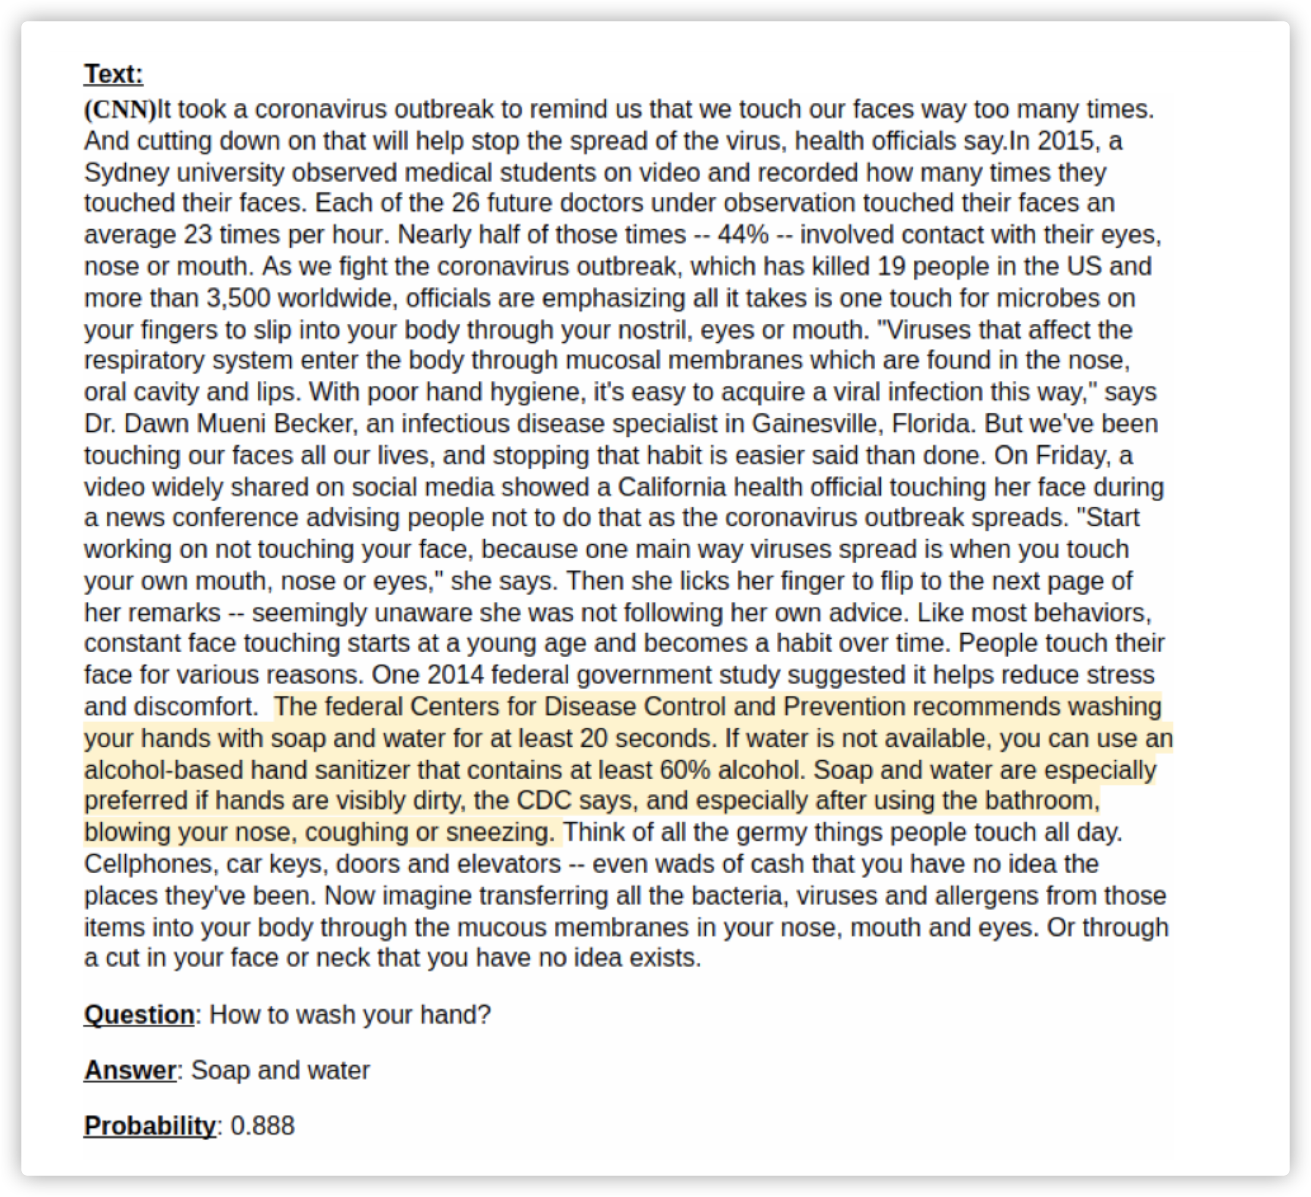
Question Answering - i think i could delete this one

Slide 66
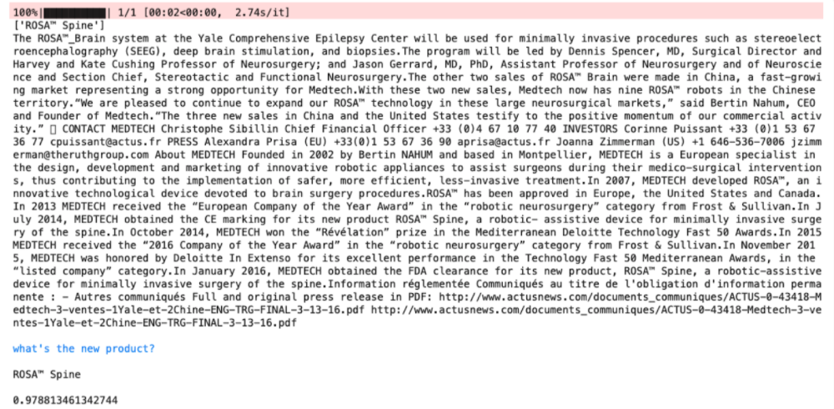
Question Answering - update the picture

Slide 67
2/8 Progress Update
Code Review: In progress
Unification of Code: Are we even doing this?
Full scale Implementation: run on big dataset
Abstract :Done!
Meetings Thursdays at 4pm

Slide 68
2/15 Progress Update
Code Review
Unification of Code
Full scale Implementation
Abstract Revisions
Presentation

